Slide 1







BILLERICAY TOWN
1. Tyrii BELL (GK)
2. Emil VENNARD
3. Macie WINDSOR
4. Gracie HICKMAN
5. Learna DANIELS
7. Elizabeth SANTIAGO
8. Nia EVANS
10. Paige DEARING
11. Aimee CAWOOD
15. Alix RALSTON
17. Melissa JONES
18. Catarina PITA
20. Megan McANISKEY
21. Tecia LEDWIDGE
22. Kelsey MORGAN
23. Abbi SMITH (C)
26. Summer ADDY
32. Emily MACKLER (GK)
Referee
Michael CLARK
HASHTAG UNITED
Aryanna ADESAN
Frances ANGEL
Blue BARTLETT-ANTWI
Lucy CONNOLLY-BRAME
Ruby GAITELY
Bonnie HORWOOD
Emel HUSEYIN
Flo JACKSON
Renee JOHNSON
Charlotte KELLETT
Teagan McWalter
Ellie MOORE
Meleri MULLAN
Elicia MULVANEY
Angela NELSON-IYE
Macey NICHOLLS
Honor NORTON
Emma SAMWAYS
Liv SMITH
Isabelle TOMLIN
Soraya WALSH
Annabelle WEBB
Assistant Referees
Andrew WOOD
Ciprian JUGANARU
BILLERICAY TOWN
v
HASHTAG UNITED
Wednesday 18 February 2026, 7:45pm
Football Programmes are obsolete. Welcome to the 21st Century
www.BTFCWomen.co.uk

Slide 2
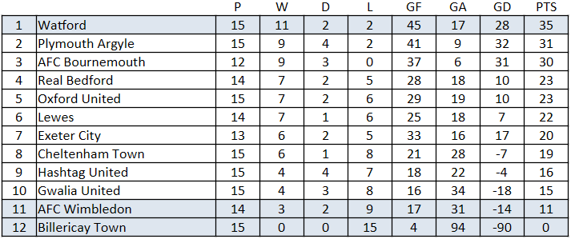


2025-26 Season
Hashtag United
Hashtag United Women traces its roots back to 2004, originally competing as Basildon Town Ladies and later C&K Basildon. The club enjoyed significant success in the Essex region, climbing through the divisions to reach the national tiers before experiencing financial difficulties that left it on the brink of closure. A major turning point arrived in April 2020 when the club, then known as AFC Basildon, merged with Hashtag United. This partnership, initiated by Hashtag's founder Spencer Owen, integrated the women's side into the club's high-profile, digital-first structure, securing its long-term future and providing a global platform for its players.
Since the merger, the "Tags" have seen a rapid rise through the national league structure. After being crowned champions of the FA Women's National League Division One South East in the 2022-23 season, the team secured promotion to the third tier of English women's football. Their momentum continued into the 2023-24 campaign, where they made history by winning the FA Women's National League Cup with a victory over Newcastle United at Kenilworth Road.
Fixtures and Results
8 February 2026
Exeter City 6-0 Billericay Town
Hashtag United 0-0 Real Bedford
Gwalia United 0-0 Plymouth Argyle
Lewes 6-0 Cheltenham Town
Watford 4-3 Oxford United
18 February 2026
AFC Wimbledon v Lewes
Billericay Town v Hashtag United
Oxford United v AFC Bournemouth
Plymouth Argyle v Exeter City
Real Bedford v Watford
19 February 2026
Cheltenham Town v Gwalia United
Date
17-Aug-25
19-Aug-25
24-Aug-25
31-Aug-25
07-Sep-25
14-Sep-25
21-Sep-25
28-Sep-25
05-Oct-25
12-Oct-25
14-Oct-25
26-Oct-25
29-Oct-25
02-Nov-25
16-Nov-25
30-Nov-25
07-Dec-25
04-Jan-26
18-Jan-25
25-Jan-26
08-Feb-26
15-Feb-26
18-Feb-26
22-Feb-26
​08-Mar-26
22-Mar-26
29-Mar-26
12-Apr-26
26-Apr-26
Versus
AFC Bournemouth
AFC Sudbury
GWALIA UNITED
Plymouth Argyle
CHATHAM TOWN
REAL BEDFORD
Watford
LONDON CITY LIONESSES ACADEMY
AFC WIMBLEDON
Oxford United
Wycombe Wanderers
Portishead Town
Hashtag United
EXETER CITY
LEWES
Cheltenham Town
AFC BOURNEMOUTH
Gwalia United
CHELMSFORD CITY
PLYMOUTH ARGYLE
Exeter City
HASHTAG UNITED RESERVES
HASHTAG UNITED
Real Bedford
WATFORD
OXFORD UNITED
AFC Wimbledon
Lewes
CHELTENHAM TOWN
Comp.
League
League Cup
League
League
League Cup
League
League
League Cup
League
League
Isthmian Cup
FA Cup
League
League
League
League
League
League
Essex Cup QF
League
League
Essex Cup SF
League
League
League
League
League
League
F-A.
0-7
1-3
1-8
0-9
0-3
0-6
0-5
0-1
1-3
0-10
2-5
0-1
0-7
0-7
1-4
0-3
0-8
1-2
1-1
0-9
0-6
1-3
Goal Scorers (Notes)
(at Ringwood Town F.C.)
T. Nee-Chambers
E. Lempek (Pen)
(at Kings Langley F.C.)
N. Evans
(at Oxford City F.C.)
​P. Dearing, S. Hart (at Burnham FC)
(at Aveley FC)
N. Evans (Pen)
(at Bishop’s Cleeve F.C.)
T. Ledwidge (Billericay won 4-2 on penalties)
N. Evans

