Slide 1







BILLERICAY TOWN
1. Tyrii BELL (GK)
2. Emily VENNARD
3. Macie WINDSOR
4. Gracie HICKMAN
5. Learna DANIELS
7. Elizabeth SANTIAGO
8. Nia EVANS
10. Paige DEARING
11. Aimee CAWOOD
15. Alix RALSTON
17. Melissa JONES
18. Catarina PITA
20. Megan McANISKEY
21. Tecia LEDWIDGE
22. Kelsey MORGAN
23. Abbi SMITH (C)
26. Summer ADDY
32. Emily MACKLER (GK)
Referee
Dan BOULDEN
WATFORD
3.. Grace GARRAD
4. Anna FILBEY
5. Anne MEIWALD
6. Sophie McLEAN
7. Lechante PAUL
8. Ava KUYKEN
9. Madison PERRY
10. Annie ROSSITER
11. Olivia CARPENTER
12. Eden SKYERS
13. Chloe SANSOM (GK)
14. Eva GRAY
15. Andria GEORGIOU
17. Megan CHANDLER
18. Poppy WILSON
19. Daisy HIND
20. Lucy LYON
21. Fly FYFE
23. Coral HAINES
25. Hope McSHEFFREY
27. Lily WHITELOCK
28. Sophie HILLYERD (GK)
99. Freda AYISI
Assistant Referees
Ceredig CATTANACH-CHELL
Calin ROGOJAN
BILLERICAY TOWN
v
WATFORD
Sunday 8 March 2026, 2:00pm
Football Programmes are obsolete. Welcome to the 21st Century
www.BTFCWomen.co.uk

Slide 2
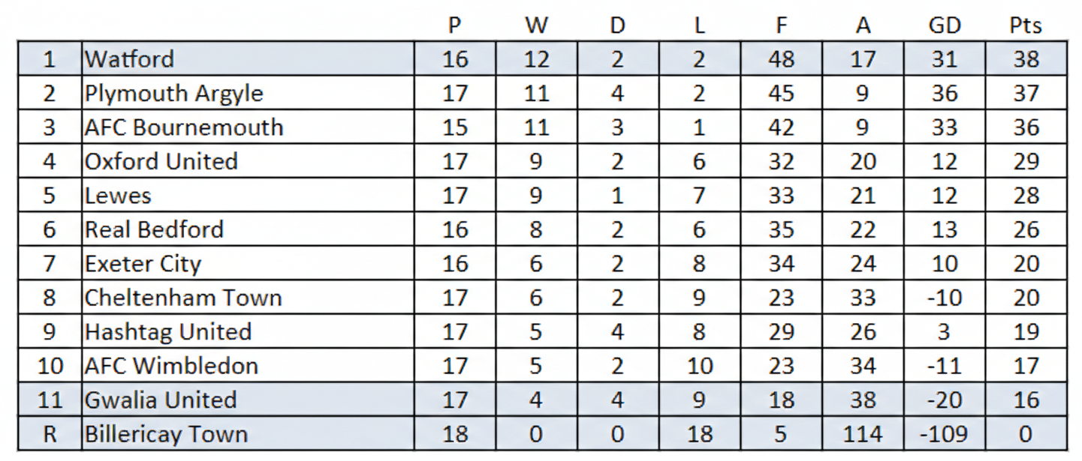


2025-26 Season
Watford
Watford FC Women, famously known as the "Golden Girls," were founded in 1970 as the Watford Supporters Ladies Club. In their early years, they were affectionately nicknamed "Willy Walker Watford Wonders" after their coaches, who were first-team players for the men's side. The club rose through the regional ranks to become a force in the Women’s Premier League, and in 2014, they reached a major milestone by becoming a founding member of the WSL 2 (now the Women's Championship). In August 2020, the club officially rebranded from Watford FC Ladies to its current name to reflect a modern commitment to equality within the sport.
In recent years, the team has experienced a period of high-stakes fluctuation between the second and third tiers of English football. After winning the FA Women's National League South title and a dramatic play-off final in the 2022-23 season, they secured a return to the Championship, though they have since continued to battle for stability in the national leagues. Historically based at various grounds including Kings Langley and Grosvenor Vale, the club recently moved to Uxbridge FC in early 2026. Despite these transitions, Watford remains a vital part of the Hertfordshire footballing landscape, focused on developing top-tier talent and maintaining a professional pathway for its players.
Fixtures and Results
Sunday 1 March 2026
AFC Wimbledon 4-0 Billericay Town
Exeter City 1-2 Oxford United
Lewes 3-1 Hashtag United
Real Bedford 1-4 AFC Bournemouth
Sunday 8 March 2026
Billericay Town v Watford
Cheltenham Town v AFC Bournemouth
Gwalia United v AFC Wimbledon
Hashtag United v Exeter City
Oxford United v Real Bedford
Plymouth Argyle v Lewes
Date
17-Aug-25
19-Aug-25
24-Aug-25
31-Aug-25
07-Sep-25
14-Sep-25
21-Sep-25
28-Sep-25
05-Oct-25
12-Oct-25
14-Oct-25
26-Oct-25
29-Oct-25
02-Nov-25
16-Nov-25
30-Nov-25
07-Dec-25
04-Jan-26
18-Jan-25
25-Jan-26
08-Feb-26
15-Feb-26
18-Feb-26
22-Feb-26
01-Mar-26
​08-Mar-26
22-Mar-26
12-Apr-26
26-Apr-26
Versus
AFC Bournemouth
AFC Sudbury
GWALIA UNITED
Plymouth Argyle
CHATHAM TOWN
REAL BEDFORD
Watford
LONDON CITY LIONESSES ACADEMY
AFC WIMBLEDON
Oxford United
Wycombe Wanderers
Portishead Town
Hashtag United
EXETER CITY
LEWES
Cheltenham Town
AFC BOURNEMOUTH
Gwalia United
CHELMSFORD CITY
PLYMOUTH ARGYLE
Exeter City
HASHTAG UNITED RESERVES
HASHTAG UNITED
Real Bedford
AFC Wimbledon
WATFORD
OXFORD UNITED
Lewes
CHELTENHAM TOWN
Comp.
League
League Cup
League
League
League Cup
League
League
League Cup
League
League
Isthmian Cup
FA Cup
League
League
League
League
League
League
Essex Cup QF
League
League
Essex Cup SF
League
League
League
League
League
League
F-A.
0-7
1-3
1-8
0-9
0-3
0-6
0-5
0-1
1-3
0-10
2-5
0-1
0-7
0-7
1-4
0-3
0-8
1-2
1-1
0-9
0-6
1-3
1-10
0-6
0-4
Goal Scorers (Notes)
(at Ringwood Town F.C.)
T. Nee-Chambers
E. Lempek (Pen)
(at Kings Langley F.C.)
N. Evans
(at Oxford City F.C.)
​P. Dearing, S. Hart (at Burnham FC)
(at Aveley FC)
N. Evans (Pen)
(at Bishop’s Cleeve F.C.)
T. Ledwidge (Billericay won 4-2 on penalties)
N. Evans
N. Evans

